Slide 1
Indicoop
Wireless Backyard Chicken Coop
IRP Presentation
Team: sdmay-20-55
Advisor: Andrew Bolstad
Notes:
Alex

Slide 2
Team Members and Roles
Project Manager
Network Lead
Flex Developer
Web Lead
Flex Developer
Hardware Lead
Notes:
Collab

Slide 3
Project Statement
Notes:
Alex
Our aim is to create a open system that can be used by any hobbyist that needs a starting point in making their Chicken Coop IOT.
-Alex

Slide 4
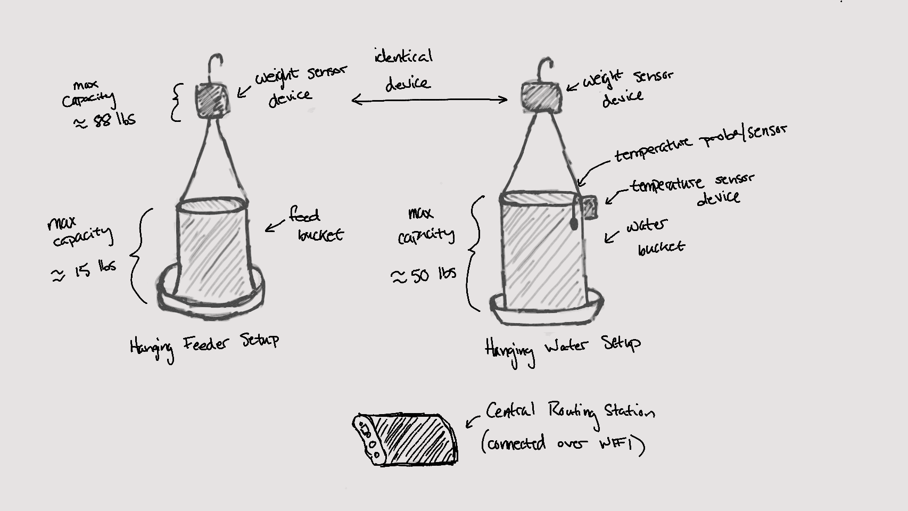
Conceptual Sketch
Notes:
Amine

Slide 5
Requirements
Agenda
Project Plan
System Design & Demo
Prototype Implementations
Schedule and Milestones
Testing Overview
Conclusion
Notes:
Armando

Slide 6
Functional Requirements
Accurately monitor (to within 0.5 lb) the weight of both feed and water
Accurately monitor (to within 1 degree) the temperature of the water
Send alerts when the water is reaching the freezing
Device shall be shielded by a food-grade composite in the event of chicken absorption.
Device shall be able to operate at temperature ranges between -10 degrees Fahrenheit to 120 degrees Fahrenheit.
User Interface shall employ user authentication to verify login credentials.
Battery life shall be able to sustain the device for a period of two weeks.
Software shall be able to push notifications when personalized thresholds have been reached.
Requirements
Notes:
Amine
Need to be able to measure and display the temperature of food and water
Need to be able to measure and display the weight of the food and water

Slide 7
Modified Functional Requirements
Original Requirement: Accurately monitor (to within 0.5 lb) the weight of both feed and water.
Modified Requirement: Accurately monitor (to within 0.5 lb) the weight of the feed.
Original Requirement: Battery life shall be able to sustain the device for a period of two weeks.
Modified Requirement: Battery life shall be able to sustain the device for a period of one week.
Requirements
Notes:
Amine
Need to be able to measure and display the temperature of food and water
Need to be able to measure and display the weight of the food and water

Slide 8
Non-Functional Requirements
Total budget for the project shall fall within the allocated $200 basic budget.
UI personalization
Design Document
Poster
Presentation
Hand-over Documentation
Requirements
Notes:
Lexi

Slide 9
Assessment of Need
Market Gap of Solution:
Lack of hobbyist monitoring.
No market solutions at price point.
No solutions with modular design.
Over-engineered designs at the market level causing a lack of flexibility for personal use.
✓
Project Plan
Notes:
Amine

Slide 10
Tasks
High level tasks in order to successfully implement our project:
Create a simple and easy to use hardware solution
Develop a user friendly front-end
Integrate software and hardware
Keep good documentation and code layout so that new features are easy to add
✓
Project Plan
Notes:
Alex

Slide 11
Risks
Chickens pecking at our wiring
Metals leaching into the water
Weather issues
Global Pandemic
✓
Project Plan
Notes:
Alex

Slide 12
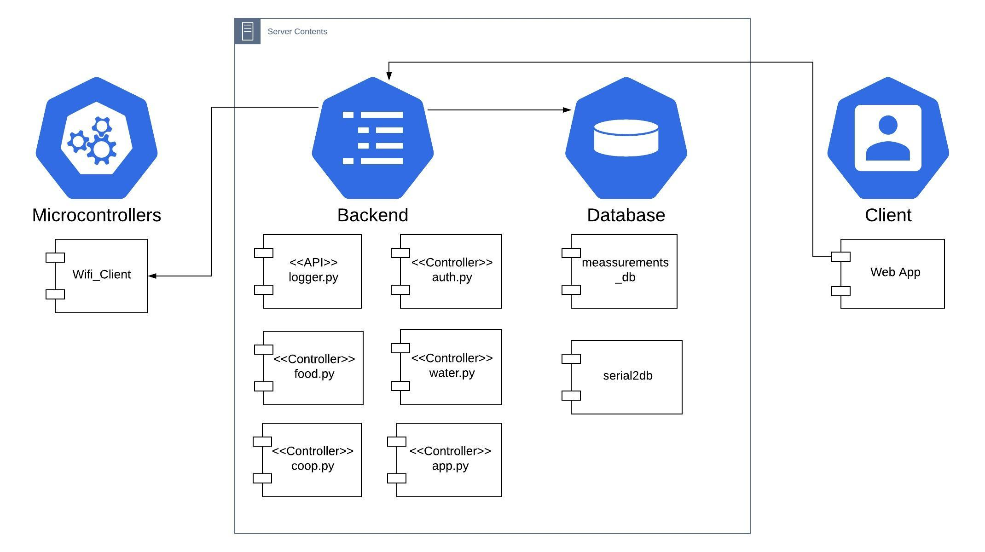
System Architecture
✓
✓
System Design
Notes:
Armando

Slide 13
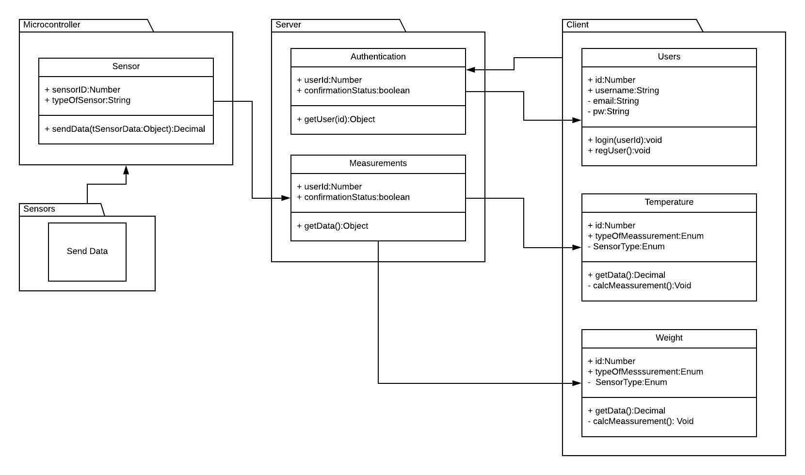
Component Diagram
✓
✓
System Design
Notes:
Armando

Slide 14
Tools used
Client
Angular
Server
MongoDB
Flask
Hardware
Solidworks
Arduino
Extra
Ubuntu 18.04
CodeServer
✓
✓
System Design
Notes:
Armando

Slide 15
Prototype Implementations
Low current draw, long battery life
Autonomous wireless capability
Determine level and temperature
Easy to modify, log data
Quick to install
Quick to change batteries
✓
✓
✓
Prototype Implementation
Notes:
Lazlow

Slide 16
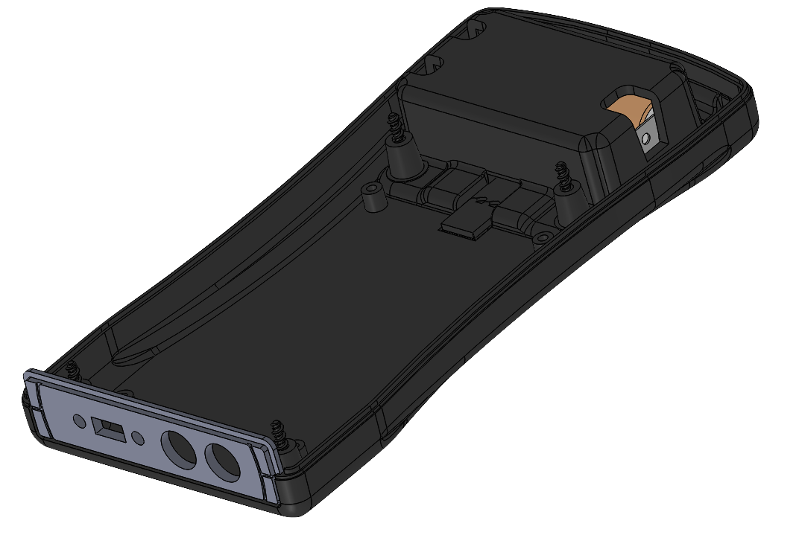
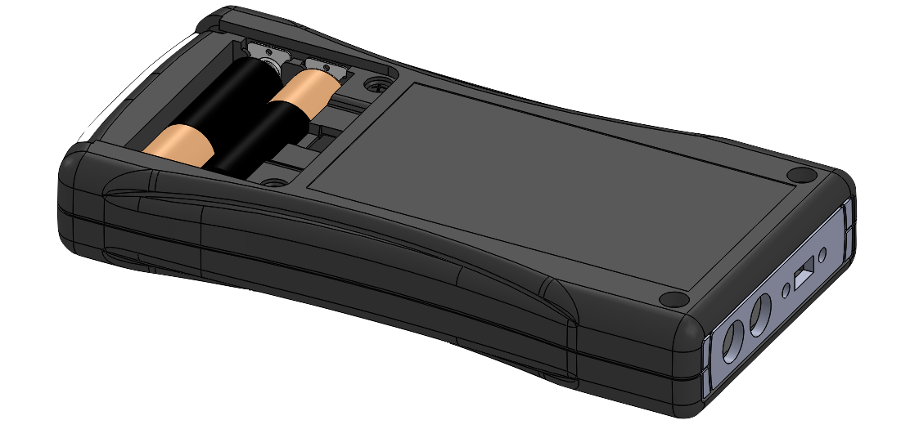
Prototype Revision A
✓
✓
✓
Prototype Implementation
Notes:
Lazlow

Slide 17
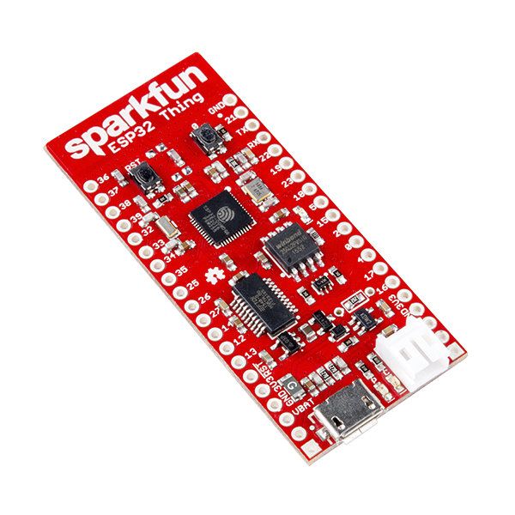
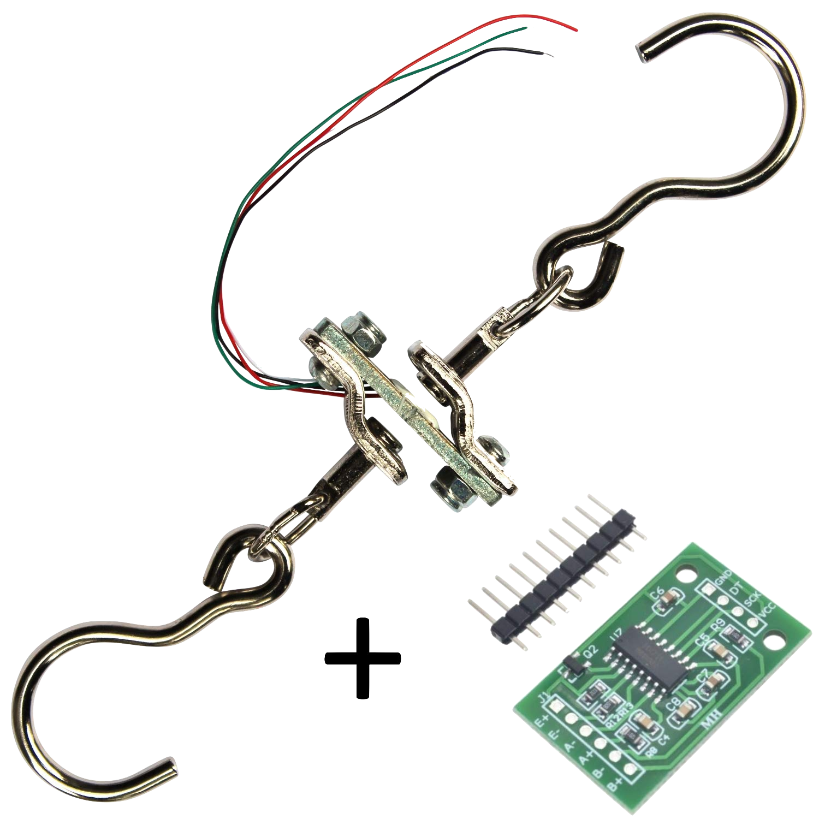
Prototype Revision A
ESP-3212 240 MHz Dual Core Processor Integrated WiFi & Bluetooth Transceiver Hardware accelerated encryption Integrated Li-Po charger 2.5 uA idle current draw
Degraw 40 kg load cell Integrated hooks Tested ADC (HX711) 1.5 mA operating current draw Low cost
✓
✓
✓
Prototype Implementation
Notes:
Lazlow

Slide 18
Project Feature Decomposition
Administrative/Organizational Duties
Device Selection
Weight Sensor
Temperature Sensor
Client Application
Server/Database
Power
Physical Housing
✓
✓
✓
Prototype Implementation
Notes:
Lexi

Slide 19
Technical Project Milestones
Feature | Milestone #1 | Milestone #2 | Milestone #3
Weight Sensor | Create weight sensing demo on board | Integrate embedded code to transfer readings over network | Install weight sensor in chicken coop (with physical housing)
Temperature Sensor | Create temperature sensing demo on board | Integrate embedded code to transfer readings over network | Install temperature sensor in chicken coop (with physical housing)
Client Application | Create basic app skeleton | Utilize APIs to query and receive data from server | Create analytics for server data
Server/Database | Create database on server | Confirm that the server can handle sensor traffic | Integrate device data with the server
Physical Housing | Create 3D printed prototype of housing | Create a CNC milled housing | Insulate wiring within the chicken coop
Power | Create a battery pack design | Create a custom power supply | Verify battery meets longevity requirements
✓
✓
✓
✓
Schedule and Milestones
Notes:
Amine

Slide 20
Technical Challenges
Idle power consumption
WiFi power consumption
Sending text messages
Integrating formatted emails
Maximizing battery capacity within form factor limitations
Maintaining a certified food-safe bill of materials, beyond RoHS requirements
Identifying potential safety risks to both the device and the chickens that could arise from design choices
Notes:
Lexi

Slide 21
Non-Technical Challenges
Replacing incorrect or broken parts.
Timeline scheduling based on product/component acquisition
Completing peer endeavors after remote work was established due to COVID-19
Notes:
Lexi

Slide 22
Project Schedule
Decide roles
Compare and choose hardware
Choose software tools
Full design schematic
APIs to receive and enter data
Prototype with accurate sensor readings
Sample application
Nov
Dec
Jan
Full weight demo
Prototype housing
Database up on server
Basic app skeleton
Full physical case
Temperature demo
Freezing point demo
Test environmental concerns
Test weatherproofing
Lock down UI
✓
✓
✓
✓
Schedule and Milestones
Notes:
Armando

Slide 23
Project Schedule
Full weatherproofed device
Web application meets basic requirements
Lock down networking
Potential redesign
App notifications
Present
Graduate
Finalize documentation
Feb
March
April
May
Explore stretch features
Full device testing
Sensor data is stored on server
Finalize testing
Bug fixing and finalization
Finalize presentation
Create poster
✓
✓
✓
✓
Schedule and Milestones
Notes:
Alex

Slide 24
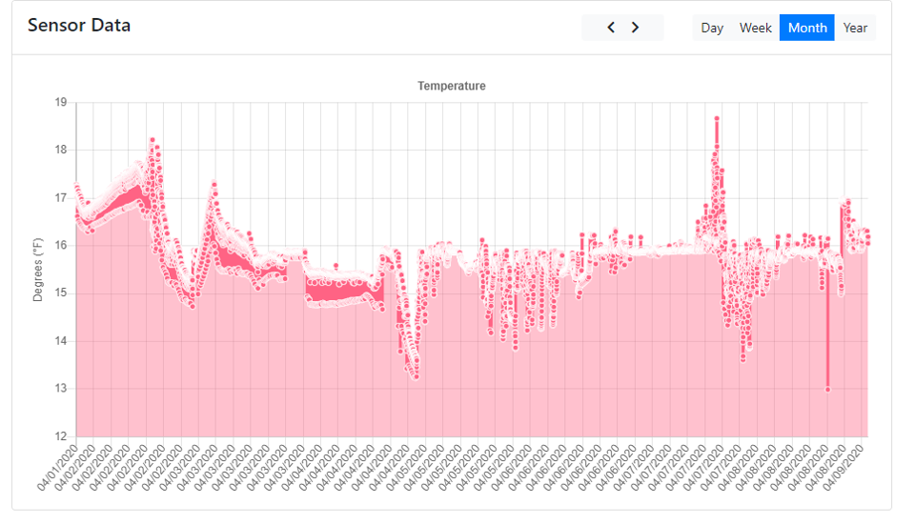
Web Application Functionality
Notes:
Lexi

Slide 25
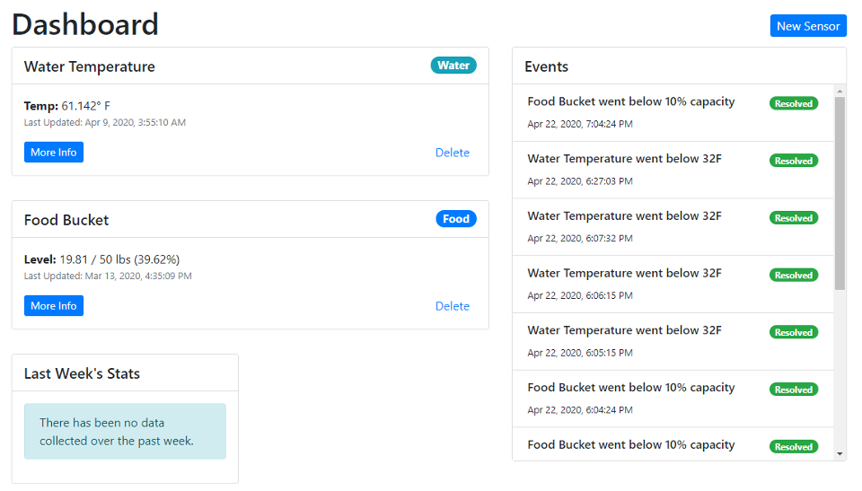
Web Application Functionality
Notes:
Lexi

Slide 26
Failure Points Overview (Test Strategy)
Untraceable IO failures from the embedded device
Network API incompatibilities
Sensor calibration and reliability issues
Missing web and server validation
✓
✓
✓
✓
✓
Test Plan
Notes:
Ryan

Slide 27
1. Untraceable IO failures from the embedded device
Edge cases such as, the wifi fails in the middle of a packet and gets hung up somewhere.
Our strategy:
Isolate outward facing functionality using the facade pattern.
Take greater care when writing and modifying that code
Add an in memory logging system for development
✓
✓
✓
✓
✓
Test Plan
Notes:
Ryan

Slide 28
2. Internal API Incompatibilities
Such as the location of an endpoint changed and the embedded device was not modified.
Our strategy:
Use a single repository to version subsystems together
Specify the APIs rather than infer from the code
Use a development environment so that we don’t need to modify production day to day
✓
✓
✓
✓
✓
Test Plan
Notes:
Ryan

Slide 29
3. Sensor calibration and reliability issues issues
In our time frame it isn’t feasible to test the reliability of sensors before we use them, or to setup a thorough mechanism for calibrating them
Our strategy:
Trust the manufacturer
✓
✓
✓
✓
✓
Test Plan
Notes:
Ryan

Slide 30
4. Missing Web and Server Validation
The server accepts weight sensor measurements as strings and it does not cause an error on the database layer
Our strategy:
Formally specify the format of sent objects
Write unit tests to ensure that only valid objects are accepted
✓
✓
✓
✓
✓
Test Plan
Notes:
Ryan

Slide 31
Project Status
Aug-Oct
Oct
Nov
Dec
Research
Gather requirements
Analyze risks
Hardware selection
Software selection
Strengthen requirements
Purchase hardware
Receiving sensor data
Database and server setup
Application setup and retrieving data
Hardware prototype created
Hardware casing created
✓
✓
✓
✓
✓
✓
Conclusion
Notes:
Lazlow

Slide 32
Accomplishments in Spring 2020
Jan
Feb
March/April
May
Working hardware prototype
Web application progress
Notifications
Weatherproofing
Power usage optimizations
Application meets base requirements
Stretch deliverables
Testing
Web Application
Finalization
Documentation
Presentation and poster
Any other final touches
✓
✓
✓
✓
✓
✓
Conclusion
Notes:
Lexi

Slide 33
Individual Contribution
Lexi
Ryan
Alex G.
Frontend setup
Backend setup
Authentication
Database modeling
Database
Sensor Implementation
Server setup
Device Communication
Power Issues
Deadline management
Sensor Implementation
Administration
Testing
✓
✓
✓
✓
✓
✓
Conclusion
Notes:
Collab

Slide 34
Individual Contribution
Alex L.
Amine
Armando
Selected, designed, and tested the hardware for the project
Designed, modeled, and created project enclosure
Assisted the software team in extending battery capacity to one week by using embedded power saving options
Created presentation poster
Project Planning
Administration
Technical Writing
Sensor Interface Design
Sensor Implementation
Communications lead
Reports manager
Created Notification System
✓
✓
✓
✓
✓
✓
Conclusion
Notes:
Collab

Slide 35
Thank you.
Questions?

